Slide 1
Lecture 29: LM3S9B96 Microcontroller – Pulse Width Modulator (PWM)

Slide 2
Stellaris® LM3S9B96 Microcontroller
Data Sheet
Chapter 22
Pulse Width Modulator (PWM)

Slide 3
Pulse Width Modulator (PWM)
Using analog signal (continuous in terms of both voltage and current)
Simple and straightforward
BUT: not easy to regulate, not power efficient, not resilient to noise
PWM is a powerful technique for digitally encoding analog signal levels
High-resolution counters are used to generate a square wave
The duty cycle of the square wave is modulated to encode an analog signal
Typical applications: switching power supplies, motor control
Power loss in the switching devices is very low: “on” no current, “off” not voltage drop

Slide 4
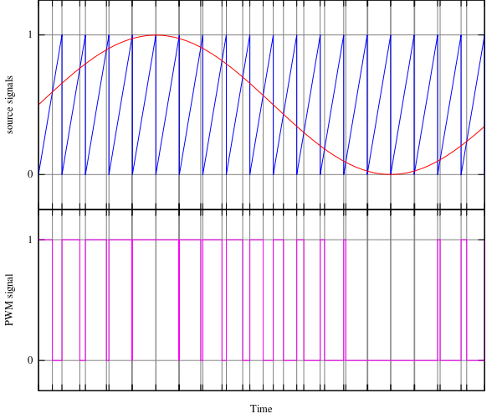
Pulse Width Modulator (PWM)

Slide 5
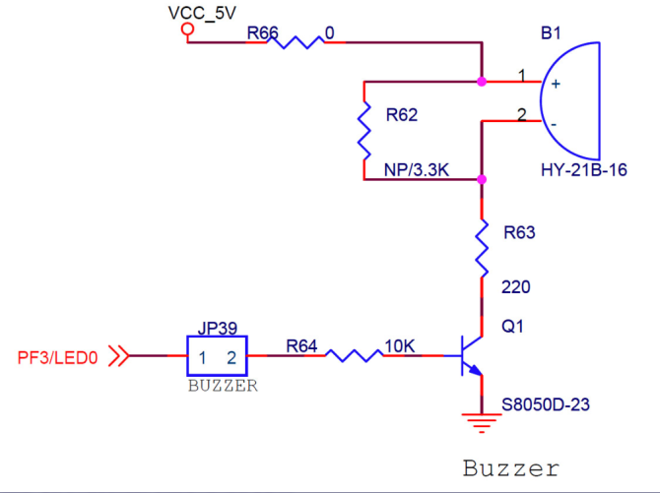
Switching Power Supplies

Slide 6
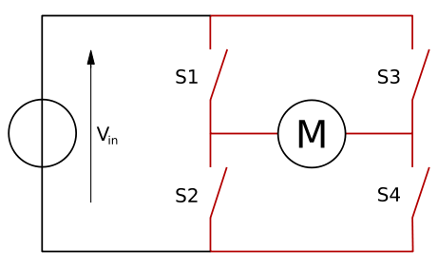
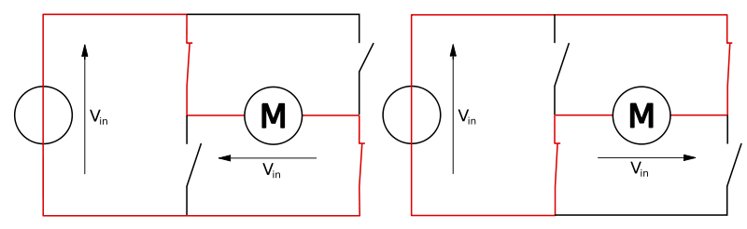
H Bridge for Motor Control
An H bridge is an electronic circuit that enables a voltage to be applied across a load in either direction
S1 | S2 | S3 | S4 | Result
1 | 0 | 0 | 1 | Motor moves right
0 | 1 | 1 | 0 | Motor moves left
0 | 0 | 0 | 0 | Motor free runs
0 | 1 | 0 | 1 | Motor brakes
1 | 0 | 1 | 0 | Motor brakes
1 | 1 | 0 | 0 | Shoot-through
0 | 0 | 1 | 1 | Shoot-through
1 | 1 | 1 | 1 | Shoot-through

Slide 7
Pulse Width Modulator (PWM)
The Stellaris PWM module consists of four PWM generator blocks and a control block
Each PWM generator block has the following features:
Provides low-latency shutdown and prevents damage to the motor being controlled
One 16-bit counter
Two PWM comparators
PWM signal generator
Dead-band generator

Slide 8
Pulse Width Modulator (PWM)
The control block determines the polarity of the PWM signals and which signals are passed through to the pins
The PWM control block has the following options:
PWM output enable of each PWM signal
Optional output inversion of each PWM signal
Optional fault handling for each PWM signal
Synchronization of timers/comparators/PWM generators across the PWM generator blocks
Interrupt status summary of the PWM generator blocks
Extended fault capabilities with multiple fault signals, programmable polarities, and filtering

Slide 9
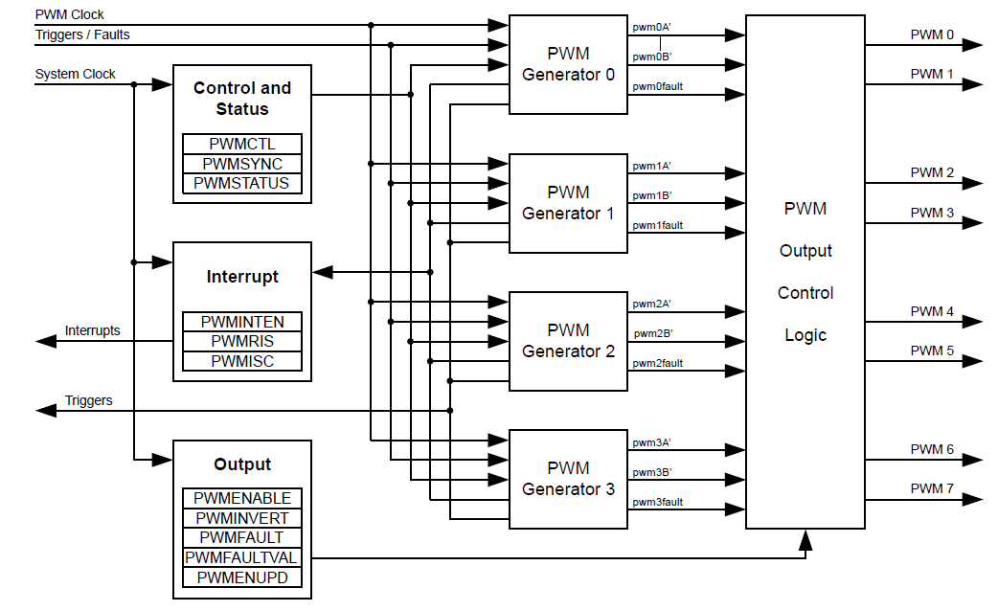
Block Diagram

Slide 10
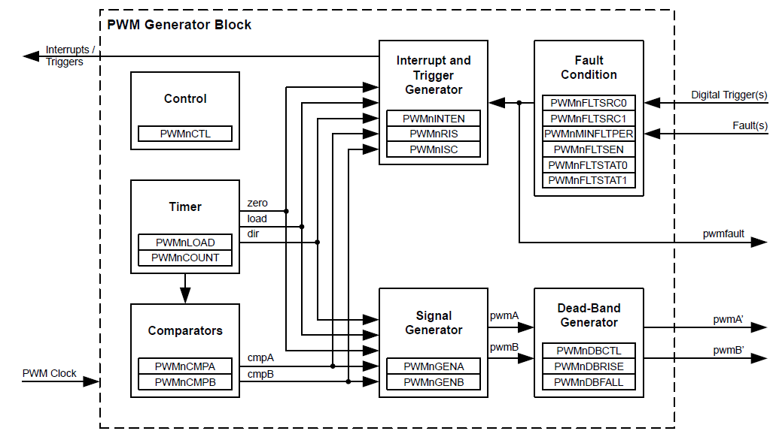
PWM Module Block Diagram

Slide 11
Functional Description
PWM Timer
In Count-Down mode:
The timer counts from the load value to zero
Goes back to the load value, and continues to count down
In Count-Up/Down mode:
The timer counts from zero up to the load value
Counts down to zero
Counts up to the load value, and so on
Count-Down mode is used for generating left- or right-aligned PWM signals, while the Count-Up/Down mode is used for generating center-aligned PWM signals

Slide 12
Functional Description
PWM Timer
Outputs three signals that are used in the PWM generation process:
The direction signal (“dir” signal): “low” when counting down, and “high” when counting up
A single-clock-cycle-width High pulse when the counter is zero (“zero” signal)
A single-clock-cycle-width High pulse when the counter is equal to the load value (“load” signal)

Slide 13
Functional Description
PWM Comparators
Each PWM generator has two comparators that monitor the value of the counter
When either comparator matches the counter, they output a single-clock-cycle-width High pulse, "cmpA" and "cmpB”
These qualified pulses are used in the PWM generation process

Slide 14
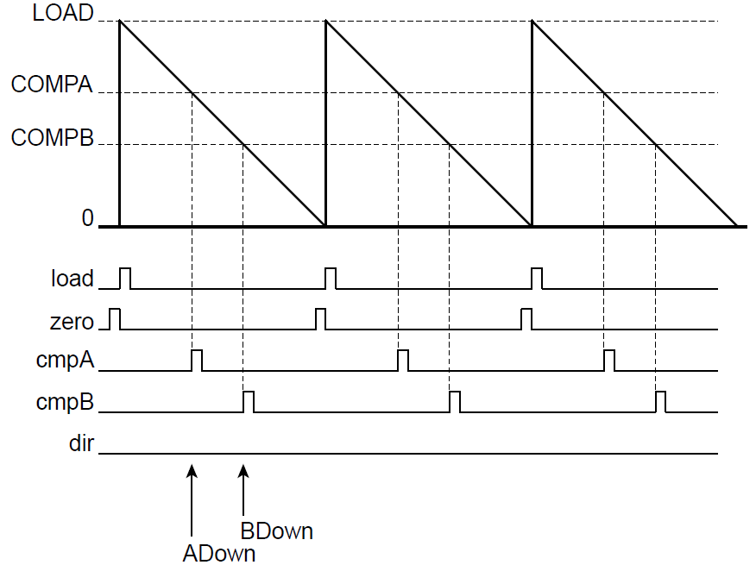

Signals Used in PWM Generation

Slide 15
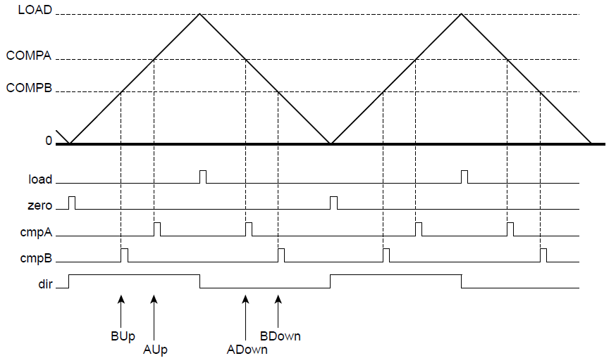
Signals Used in PWM Generation

Slide 16
Functional Description
PWM Signal Generator
takes the “load”, “zero”, “cmpA”, and “cmpB” pulses (qualified by the dir signal)
generates two internal PWM signals, “pwmA” and “pwmB”
In Count-Down mode: zero, load, match A down, and match B down
In Count-Up/Down mode: zero, load, match A down, match A up, match B down, and match B up
For each event, the effect on each output PWM signal is programmable

Slide 17
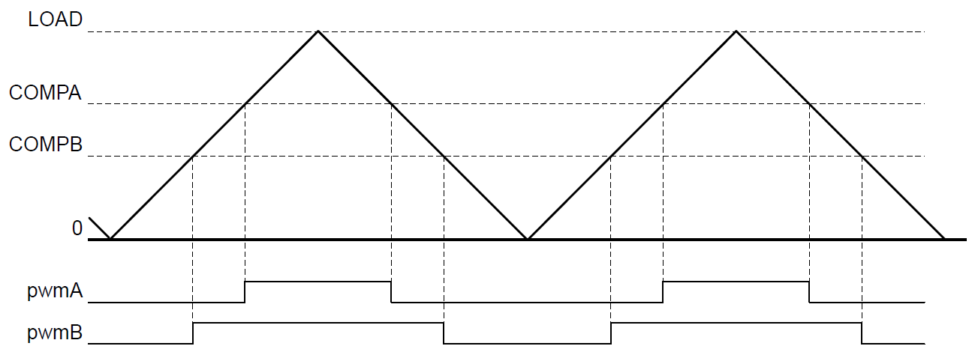
PWM Generation Example In Count-Up/Down Mode
pwmA is set to drive High on match A up, drive Low on match A down, and ignore the other four events
pwmB is set to drive High on match B up, drive Low on match B down, and ignore the other four events

Slide 18
Functional Description
Dead-Band Generator
The generated pwmA and pwmB signals can be passed to the dead-band generator
If the dead-band generator is disabled, pwmA and pwmB signals will not be modified
If the dead-band generator is enabled, the pwmB signal is lost and two PWM signals are generated based on the pwmA signal, pwmA’ and pwmB’
pwmA’ is pwmA with the rising edge delayed
pwmB’ is the iversion of pwmA with a delay added between the falling edge of pwmA and the rising edge of pwmB’

Slide 19
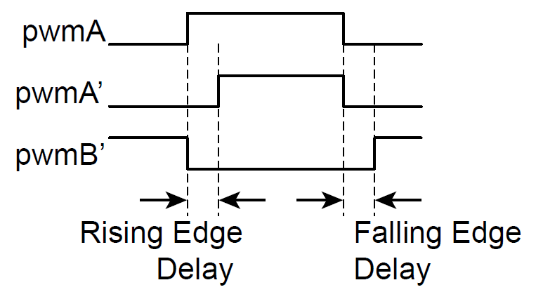
PWM Dead-Band Generator

Slide 20
Functional Description
Interrupt/ADC-Trigger Selector
The same four (or six) counter events can be used to generate an interrupt
Any of these events or a set of these events can be selected
Different or the same events can be selected to generate an ADC trigger

Slide 21
Functional Description
Synchronization
Four PWM generators providing eight PWM outputs
Unsynchronized: each PWM generator and its two output signals are used alone, independent of other PWM generators
Synchronized: The PWM generator and its two outputs signals are used in conjunction with other PWM generators using a common and unified time base
Set the “SYNCn” bits in the PWMSYNC register will cause corresponding PWM generators reset their counter together

Slide 22
Functional Description
Fault Conditions
When fault conditions happen, the PWM function must be stopped and the PWMn signals should be set to a safe state
Two basic situations cause fault conditions:
The microcontroller is stalled and cannot perform the necessary computation in the time required for motion control
An external error or event is detected
The following inputs can be used to generate a fault condition
FAULTn fault input pins
A stall of the controller generated by the debugger
The trigger of an ADC digital comparator
Fault conditions are calculated on a per-PWM generator basis

Slide 23
Functional Description
Output Control Block
Takes care of the final conditioning of the pwmA' and pwmB' signals before they go to the pins as the PWMn signals.
The set of PWM signals that are actually enabled to the pins can be modified via the PWNENABLE register
During fault conditions, PWMn usually must be driven to safe values
Use PWMFAULT register to specify whether the output continues to use the generated signal or an encoding specified in the PWMFAULTVAL register
A final inversion can be applied to any of the PWMn signals using the PWMINVERT register

Slide 24
Initialization and Configuration
The following example shows how to initialize PWM Generator 0 with a 25-kHz frequency, a 25% duty cycle on the PWM0 pin, and a 75% duty cycle on the PWM1 pin, assuming the system clock is 20 MHz
Enable the PWM clock by writing a value of 0x0010.0000 to the RCGC0 register
Enable the clock to the appropriate GPIO module via the RCGC2 register
In the GPIO module, enable the appropriate pins for their alternate function using the GPIOAFSEL register
Configure the PMCn fields in the GPIOPCTL register to assign the PWM signals to the appropriate pins
Configure the RCC register in the System Control module to use the PWM divide (USEPWMDIV) and set the divider (PWMDIV) to divide by 2 (000).

Slide 25
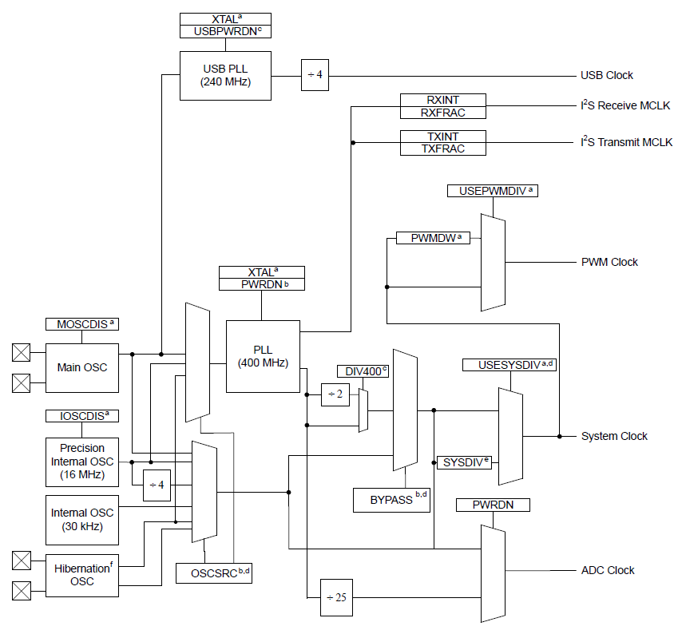
Recall: Clock Control

Slide 26
Initialization and Configuration
Configure the PWM generator for countdown mode with immediate updates to the parameters
Write the PWM0CTL register with a value of 0x0000.0000
Write the PWM0GENA register with a value of 0x0000.008C
Write the PWM0GENB register with a value of 0x0000.080C
Set the period: for a 25-KHz frequency, the period = 1/25,000, or 40 microseconds. The PWM clock source is 10MHz. Thus, there are 400 clock ticks per period. Use this value to set the PWM0LOAD register. In Count-Down mode, set the LOAD field in the PWM0LOAD register to the requested period minus one
Write the PWM0LOAD register with a value of 0x0000.018F

Slide 27
Initialization and Configuration
Set the pulse width of the PWM0 pin for a 25% duty cycle: Write the PWM0CMPA register with a value of 0x0000.012B
Set the pulse width of the PWM1 pin for a 75% duty cycle: Write the PWM0CMPB register with a value of 0x0000.0063
Start the timers in PWM generator 0 : Write the PWM0CTL register with a value of 0x0000.0001
Enable PWM outputs: Write the PWMENABLE register with a value of 0x0000.0003

Slide 28
Register Map & Description
Sub-Chapter 22.5 and 22.6

Slide 29
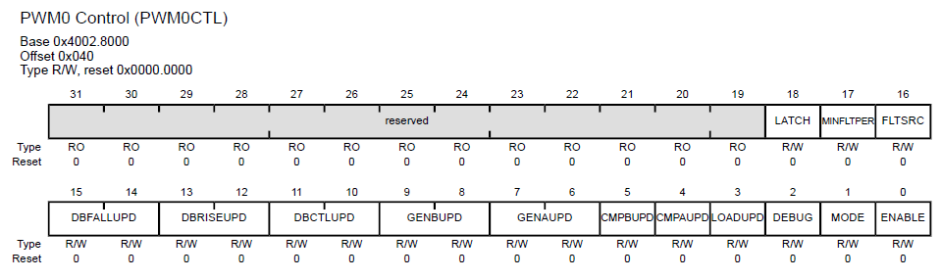
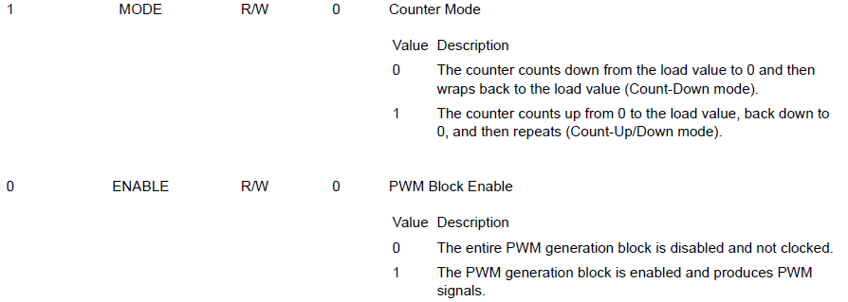
Key Registers: PWMnCTL

Slide 30
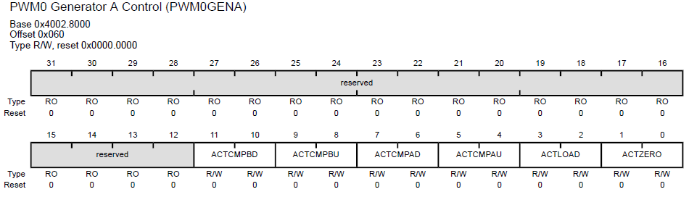
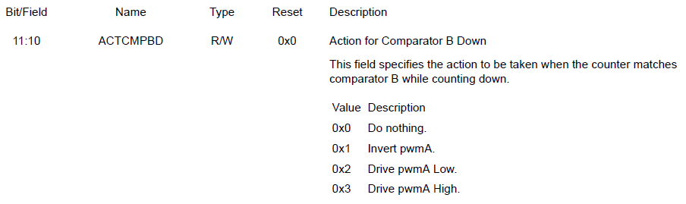
Key Registers: PWMnGENA, PWMnGENB

Slide 31
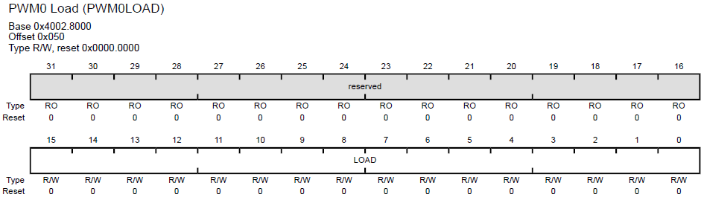

Key Registers: PWMnLOAD

Slide 32
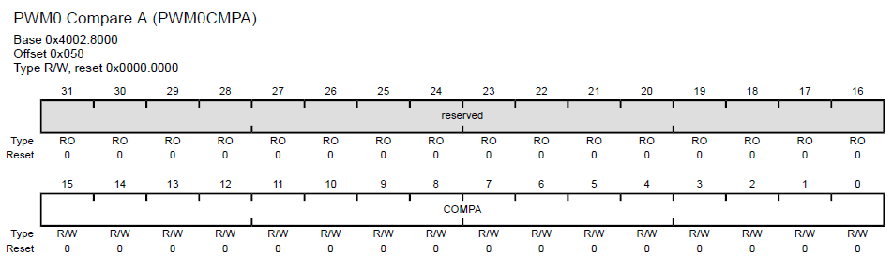
Key Registers: PWMnCMPA, PWMnCMPB

Slide 33
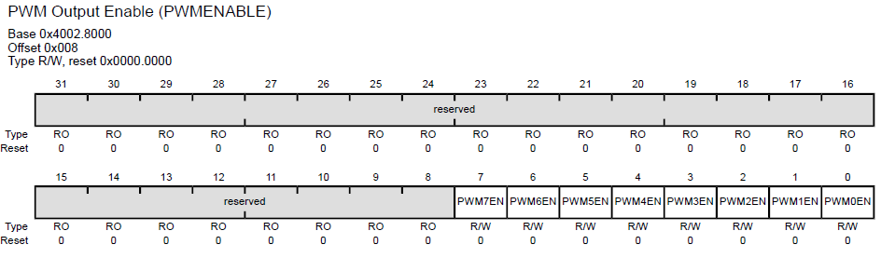
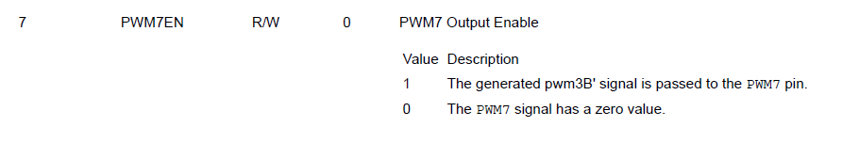
Key Registers: PWMENABLE

